Slide 1
Lecture 17
DataCorrelation, Covariance, Bregman divergence.

Slide 2
Data Correlation
Data correlation refers to the statistical relationship between two or more variables.
It measures the strength and direction of the linear relationship between these variables.
Correlation does not imply causation; even if two variables are correlated, it doesn't necessarily mean that changes in one variable cause changes in the other.

Slide 3
Types of Correlation
The most common measure of correlation is the Pearson correlation coefficient, denoted as "r". It ranges from -1 to 1:
A positive value close to 1 indicates a strong positive correlation, meaning that as one variable increases, the other tends to increase as well.
A negative value close to -1 indicates a strong negative correlation, meaning that as one variable increases, the other tends to decrease.
A value close to 0 indicates a weak or no linear correlation between the variables.

Slide 4
Interpretations from Correlation
If the relationship between variables is nonlinear, the correlation coefficient might not accurately capture the true relationship.
Correlation can be visualized using scatter plots, where data points are plotted on a graph with one variable on the x-axis and the other on the y-axis.
Patterns in the scatter plot can provide insights into the relationship between the variables.
Correlation does not determine causation; While correlated variables might suggest a potential relationship, additional research and analysis are needed to establish any causal link between them.

Slide 5
Example
Student | Hours Studied (X) | Exam Score (Y)
A | 2 | 65
B | 1.5 | 60
C | 3 | 75
D | 2.5 | 70
E | 1.75 | 62
F | 4 | 80
G | 2.25 | 68
H | 3.5 | 72
To determine whether there is a correlation between the "Hours Studied" and "Exam Score" data . Calculate the Pearson correlation coefficient and interpret the results.

Slide 6
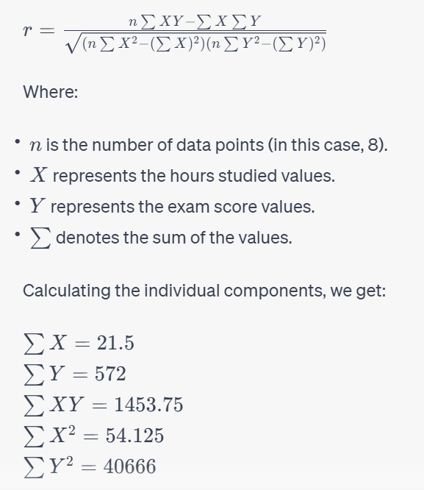
Computation of Correlation

Slide 7
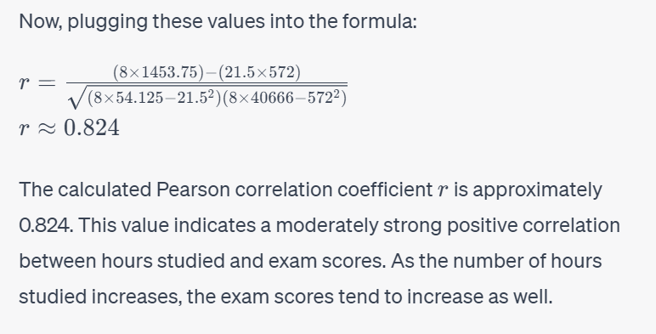
Result of Computation & Interpretation

Slide 8
Covariance
Will repeat Lecture 11 here…

Slide 9
Covariance
In statistics and probability theory, covariance deals with the joint variability of two random variables: x and y.
Generally, it is treated as a statistical tool used to define the relationship between two variables.
Covariance is a measure of the relationship between two random variables and to what extent, they change together. Or we can say, in other words, it defines the changes between the two variables, such that change in one variable is equal to change in another variable.
This is the property of a function of maintaining its form when the variables are linearly transformed.
Covariance is measured in units, which are calculated by multiplying the units of the two variables

Slide 10
Types of Covariance
Positive Covariance
If the covariance for any two variables is positive, that means, both the variables move in the same direction. Here, the variables show similar behaviour. That means, if the values (greater or lesser) of one variable corresponds to the values of another variable, then they are said to be in positive covariance.
Negative Covariance
If the covariance for any two variables is negative, that means, both the variables move in the opposite direction. It is the opposite case of positive covariance, where greater values of one variable correspond to lesser values of another variable and vice-versa

Slide 11
Covariance formula
Covariance formula is a statistical formula, used to evaluate the relationship between two variables.
It is one of the statistical measurements to know the relationship between the variance between the two variables.
Let us say X and Y are any two variables, whose relationship has to be calculated.
Thus the covariance of these two variables is denoted by Cov(X,Y).

Slide 12
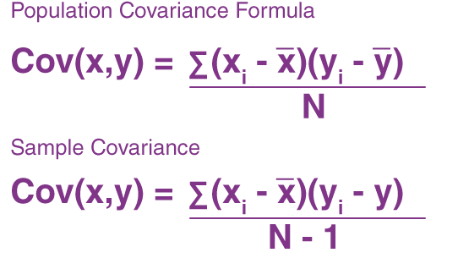
Covariance Formula
Where,
xi = data value of x
yi = data value of y
x̄ = mean of x
ȳ = mean of y
N = number of data values.

Slide 13
Example: Calculate the coefficient of covariance for the following data:
X | 2 | 8 | 18 | 20 | 28 | 30
Y | 5 | 12 | 18 | 23 | 45 | 50
Number of observations = 6
Mean of X = 17.67
Mean of Y = 25.5
Cov(X, Y) = (⅙) [(2 – 17.67)(5 – 25.5) + (8 – 17.67)(12 – 25.5) + (18 – 17.67)(18 – 25.5) + (20 – 17.67)(23 – 25.5) + (28 – 17.67)(45 – 25.5) + (30 – 17.67)(50 – 25.5)]
= 157.83

Slide 14
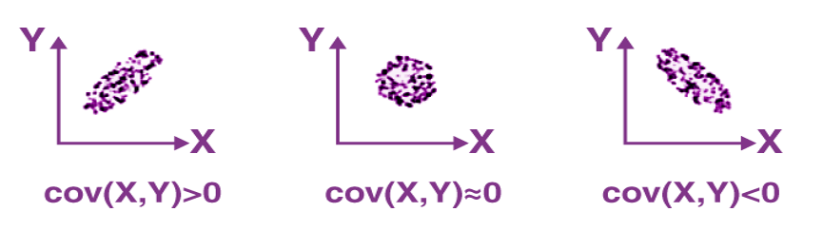
Interpretations Covariance

Slide 15
Interpretations Covariance
If cov(X, Y) is greater than zero, then we can say that the covariance for any two variables is positive and both the variables move in the same direction.
If cov(X, Y) is less than zero, then we can say that the covariance for any two variables is negative and both the variables move in the opposite direction.
If cov(X, Y) is zero, then we can say that there is no relation between two variables.

Slide 16

Correlation Coefficient & Formula
Correlation estimates the depth of the relationship between variables. It is the estimated measure of covariance and is dimensionless. In other words, the correlation coefficient is a constant value always and does not have any units. The relationship between the correlation coefficient and covariance is given by:
ρ(X,Y) = correlation between the variables X and Y
Cov(X,Y) = covariance between the variables X and Y
σX = standard deviation of the X variable
σY = standard deviation of the Y variable

Slide 17
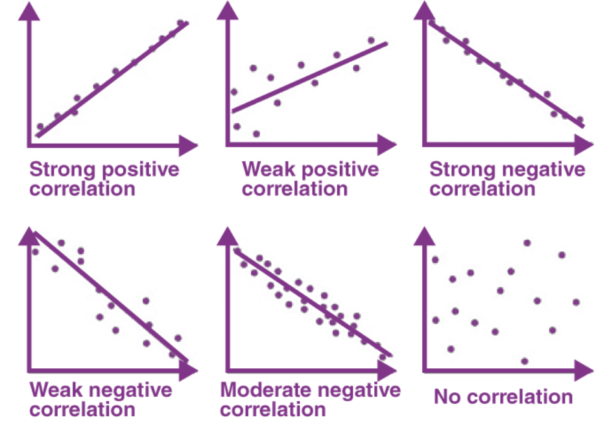
Graphical representation of correlation among two variables

Slide 18
Difference Between Covariance-Correlation
Covariance | Correlation
It is a measure to show the extent to which given two random variables change with respect to each other. | It is a measure used to describe how strongly the given two random variables are related to each other.
It is a measure of correlation. | It is defined as the scaled form of covariance.
The value of covariance lies between -∞ and +∞. | The value of correlation lies between -1 and +1.
It indicates the direction of the linear relationship between the given two variables. | It measures the direction and strength of the linear relationship between the given two variables.

Slide 19
Bregman Divergence

Slide 20
Bregman divergence
In mathematics,specifically statistics and information geometry, a Bregmandivergence or Bregman distance is a measure of difference between two points, defined in terms of a strictly convex function; they form an important class of divergences. When the points are interpreted as probability distributions – notably as either values of the parameter of a parametric model or as a data set of observed values – the resulting distance is a statistical distance . The most basic Bregman divergence is the squared Euclidean distance.

Slide 21
History of Bregman divergences
Bregman divergences are similar to metrics, but satisfy neither the triangle inequality (ever) nor symmetry (in general). However, they satisfy a generalization of the Pythagorean theorem , and in information geometry the corresponding statistical manifold is interpreted as a (dually) flat manifold. This allows many techniques of optimization theory to be generalized to Bregman divergences, geometrically as generalizations of least squares.
Bregman divergences are named after Lev M. Bregman , who introduced the concept in 1967.

Slide 22
Applications of Bregman divergences
In machine learning, Bregman divergences are used to calculate the bi-tempered logistic loss, performing better than the softmax function with noisy datasets

Slide 23
Bregman divergence
Let ψ : Ω → R be a function that is:
a) strictly convex,
b) continuously differentiable,
c) defined on a closed convex set Ω.
Then the Bregman divergence is defined as
∆ψ(x, y) =( ψ(x) − ψ(y) )− (h∇ψ(y), x − yi), ∀ x, y ∈ Ω.
That is, the difference between the value of ψ at x and the first order Taylor expansion of ψ around y evaluated at point x.

Slide 24
Bregman Divergences
φ(z)
φ(x)
d_{φ}(x,y)
(x−y). _{φ}’(y)
φ(y)
y
x
z
φ is strictly convex, differentiable
d_{φ}(x, y) = φ(x) − φ(y) − (x − y, ∇φ(y))

Slide 25
Summary of Bregman Divergence
Bregman divergence is a way to measure the "difference" or "distance" between two points in a mathematical space. Imagine you have two points, A and B, in a space.
Bregman divergence helps you quantify how much "stuff" you need to move from point A to point B.

Slide 26
Bregman Divergence - Example
Think of it like this: Imagine point A is your starting point, and point B is your destination.
Instead of using a regular ruler to measure the distance, you have a special ruler that accounts for the shape of the space you're in.
This special ruler considers how the space is curved or bent.
When you measure the distance between A and B using this special ruler, you get the Bregman divergence.

Slide 27
Key idea: Bregman
Bregman divergence captures not only how far apart the points are, but also how they differ in some specific way.
It's like measuring the difference in a unique and tailored manner for the specific space you're in.
In summary, Bregman divergence is a way to measure the difference between two points in a space, taking into account the specific characteristics of that space.
It's a bit like using a custom-made measuring tool that considers the shape of the space to provide a more meaningful measurement of "difference."

Slide 28
Thank you!!!

